Slide 1
BFX-AT100 (T99X171.00) Scan Bluetooth Fail Failure Analysis Report
Prepared by: PE – Nguyen Nhat Nam
Date: July 14th 2022

Slide 2
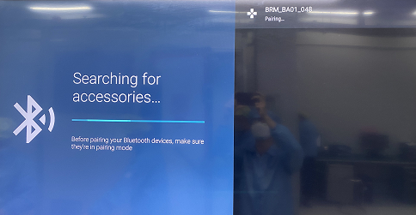
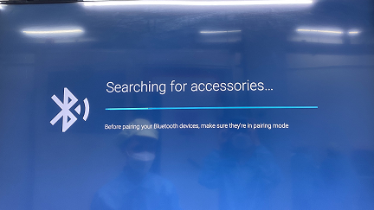
Description of Problems
Issue Description
ALT customer brought 1pcs Scan Bluetooth (BT) fail (SN of NG product: YUG24Y1) to Vietnam for further analyzing on 05.04.2022.
Scan Bluetooth OK
Always in scan BT status

Slide 3
Containment
Recheck OBA, Take X-ray and VI PCBA
OBA environment verification → Scan BT fail.
Open housing checking.
Baking PCBA with 70ºC in 2 days.
Recheck OBA environment verification → Scan BT fail.
Take X-ray and VI PCBA → Did not find out any abnormal.

Slide 4
Failure Analysis – 1
1. Check Customer feedback sample production test log.
- Check SFIS data record test log is normal, BT function working normal ( BT function test at FT1 station ).
...
FT1
...
I
1. Connect to DUT
2. Check SN, BT mac
3. Read device ID
4. Check Playready
5. Check LED (off , red, blue , green)
6. Check 4K TV
7. Check HDMI Video, Audio
8. Check HDMI VP9/H265
9. Check HDCP 1.4, HDCP 2.2 key
10. Check USB Storage
11. Check CHANNELUP/DOWN button
12. Check Audio Record
13. Check IR
14. Scan BT
15. Set burnin on (5% set this command)
Test plan FT1 station
Summary:
Didn’t find out any abnormal related to BT function.

Slide 5
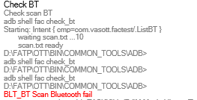
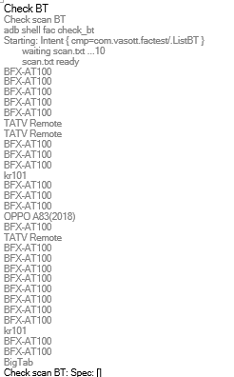
Failure Analysis – 2
2. Retest Scan BT fail unit at FT1 station
Retest scan BT fail on random 5 test machines at FT1 station:
Test Machine Name | Result
L10T99FT1001 | Fail
L10T99FT1003 | Fail
L10T99FT1006 | Fail
L10T99FT10010 | Fail
L10T99FT10013 | Fail
Scan BT Fail
Scan BT Pass
Summary: .
- Test program can cover this issue 100% at FT1 station.

Slide 6
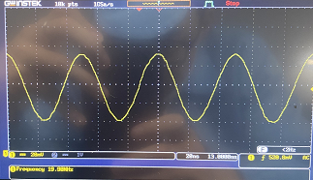
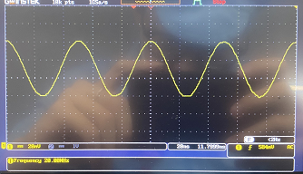
Failure Analysis – 3
3. Measure crystal signal
Measure crystal signal at BT_XTAL_OUT pin of Y1001 (BT Block)
- Crystal signal didn’t have abnormal ( Value: 19.98MHz, Spec: 20MHz).
NG sample
OK sample
Summary: Measure Crystal signal didn’t have abnormal ( Value: 19.98MHz, Spec: 20MHz).

Slide 7
Failure Analysis – 4
4. Measure Power Supply
Measure power supply of NG sample and OK sample, result as below:
- Power supply of BT block has abnormal
Voltage measurement
Location | Voltage power spec(±5% VCC) | Ok sample | NG sample
L301 (VDDCPU - 0.8V) | (0.76-0.84)V | Pass | Pass
L302 (VDD_EE - 0.8V) | (0.76-0.84)V | Pass | Pass
L303 (P1V2 - 1.2V) | (1.14-1.26)V | Pass | Pass
L304 (P3V3 - 3.3V) | (3.135-3.465)V | Pass | Pass
R324 (P1V8 - 1.8V) | (1.71-1.89)V | Pass | Pass
R325 (P2V5 - 2.5V) | (2.375-2.625)V | Pass | Pass
R1012 (BTUART_A_CTS_N) | 0V | Pass | 3.046V - Fail
Summary: Check power supply of BT block (U1001) found out the output voltage abnormal on R1012 - BTUART_A_CTS_N pin ( Normal sample ~ 0V, NG sample ~ 3.046V).

Slide 8
Impedance & Voltage Diode Measurement – 1
Remove and measure impedance U1001 of NG sample and OK sample, result as table below:
No# | Pin name | OK sample |  | NG sample |  | No# | Pin name | OK sample |  | NG sample
 |  | Impedance (Ω) | VF voltage (VD) | Impedance (Ω) | VF voltage (VD) |  |  | Impedance (Ω) | VF voltage (VD) | Impedance (Ω) | VF voltage (VD)
A1 | BT_ PAVDD2P5 | 1.296M | 0.472 | 1.329M | 0.472 | B5 | BT_GPIO_5 | 2.523M | 0.764 | 2.527M | 0.765
A2 | RFOP | 95.3K | NC | 96.4K | NC | B6 | BT_GPIO_6 | 2.544M | 0.769 | 2.538M | 0.77
A3 | BT_ PLLVDD1P2 | 1.141M | 0.493 | 1.336M | 0.497 | B7 | 2S_CLK/ PCM_CLK | 2.485M | 0.739 | 2.542M | 0.764
A4 | XO_IN | 2.771M | 0.782 | 2.910M | 0.784 | B8 | VDDC | 18.94K | 0.476 | 19.38K | 0.472
A5 | XO_OUT | 2.758M | 0.752 | 2.899M | 0.755 | C1 | BT_ VCOVDD1P2 | 1.525M | 0.507 | 1.664M | 0.521
A6 | RST_N | 2.524M | 0.769 | 2.564M | 0.77 | C2 | VSS | 0.5 | 0 | 0.6 | 0
A7 | VSSC | 0 | 0 | 0.5 | 0 | C5 | BT_GPIO_3 | 2.531M | 0.768 | 2.537M | 0.769
A8 | I2S_DO/ PCM_OUT | 2.502M | 0.763 | 2.540M | 0.764 | C6 | BT_GPIO_7 | 2.554M | 0.743 | 2.559M | 0.77
B1 | BT_LNAVDD1 P2 | 2.240M | 0.52 | 2.390M | 0.524 | C7 | I2S_DI/ PCM_IN | 2.510M | 0.763 | 2.527M | 0.763
B2 | VSS | 0 | 0 | 0 | 0 | C8 | I2S_WS/ PCM_SYNC | 2.522M | 0.763 | 2.541M | 0.763
B3 | VSS | 0 | 0 | 0 | 0 | D1 | VBAT | 2.802M | 0.529 | 2.807M | 0.526
B4 | BT_ IFVDD1P2 | 0.765M | 0.423 | 0.848M | 0.437 | D2 | VSS | 4 | 0 | 5.3 | 0

Slide 9
Impedance & Voltage Diode Measurement – 2
No# | Pin name | OK sample |  | NG sample |  | No# | Pin name | OK sample |  | NG sample
 |  | Impedance (Ω) | VF voltage (VD) | Impedance (Ω) | VF voltage (VD) |  |  | Impedance (Ω) | VF voltage (VD) | Impedance (Ω) | VF voltage (VD)
D5 | JTAG_SEL | 2.528M | 0.74 | 2.430M | 0.757 | F4 | BT_UART _TXD | 2.518M | 0.757 | 2.511M | 0.762
D6 | BT_GPIO_4 | 2.526M | 0.764 | 2.513M | 0.764 | F5 | BT_UART _RXD | 2.493M | 0.765 | 2.527M | 0.762
D7 | SPI2_CSN | 2.495M | 0 | 2.508M | 0.763 | F6 | VSS | 0 | 0.764 | 0.6 | 0
D8 | SPI2_MISO_ I2C_SCL | 2.497M | 0.764 | 2.516M | 0.763 | F7 | BT_GPIO_1/ BT_HOST_ WAKE | 2.524M | 0.763 | 2.507M | 0.762
E1 | VDD2P5_IN | 1.821M | 0.763 | 1.874M | 0.527 | F8 | BT_GPIO_0/ BT_DEV _WAKE | 2.496M | 0.529 | 2.529M | 0.761
E2 | VDD2P5_ OUT | 0.696M | 0.608 | 0.696M | 0.758 | G1 | BT_VDD _USB | 3.556M | 0.758 | 3.586M | 0.606
E4 | BT_GPIO_2 | 2.518M | 0.752 | 2.500M | 0.764 | G2 | BT_HUSB _DP | 2.557M | 0.764 | 2.527M | 0.75
E7 | SPI2_CLK | 2.499M | 0.752 | 2.516M | 0.763 | G3 | BT_HUSB _DN | 2.560M | 0.764 | 2.527M | 0.758
E8 | SPI2_MOSI_ I2C_SDA | 2.509M | 0.763 | 2.542M | 0.764 | G4 | BT_UART _CTS_N | 2.496M | 0.764 | 2.514M | 0.762
F1 | VDDC_OUT | 2.963M | 0.526 | 2.924M | 0.719 | G5 | VDDO | 2.539M | 0.719 | 2.522M | 0.523
F2 | BT_XTAL _STRAP_1 | 2.556M | 0.475 | 2.546M | 0.767 | G6 | VDDC | 19.07K | 0.769 | 18.90K | 0.47
F3 | BT_UART _RST_N | 2.498M | 0.764 | 2.516M | 0.762 | G7 | BT_TM1 | 2.513M | 0.764 | 2.507M | 0.761
 |  |  |  |  |  | G8 | BT_CLK _REQ | 2.518M | 0.769 | 2.541M | 0.767
Summary: Impedance & voltage diode measure U1001 didn’t find out abnormal.

Slide 10
Swap Verification
U1001 swap verification
- Swap verification between NG U1001 and OK U1001, result as table below:
Scan Bluetooth | 1 | 2 | 3 | 4 | 5
OK board + OK U1001 | OK | OK | OK | OK | OK
NG board + NG U1001 | NG | NG | NG | NG | NG
OK board + NG U1001 | NG | NG | NG | NG | NG
NG broad + OK U1001 | OK | OK | OK | OK | OK
Summary:
- Swap OK U1001 into NG board and measure voltage of R1012 pin → Voltage normal ( 0V ).
- As analysis above this issue follow U1001 ( P/N: 001.01313.005 ) component.

Slide 11
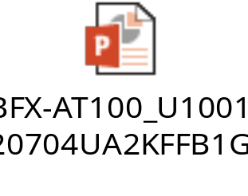
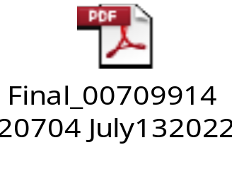
Conclusion
As analysis above this issue follow U1001 ( P/N: 001.01313.005 ) component.
Send NG material and report to SQE: Mr. Ha. Due date: 05/31/2022.
Vendor CYPRESS send the internal report ( Draft version ) on 07/05/2022. Done.
CYPRESS vendor updated the final report on 07/13/2022.
See an attachment file below. ( Attachment file 1 is Fii FA report, Attachment file 2 is Cypress vendor FA report )

